Slide 1



FeedNeed
Share Food Share Hope
Online Food Donation and Waste Management System

Slide 2
VIDYAWATI MUKAND LAL GIRLS COLLEGE, GHAZIABAD
Presentation ON
“FEEDNEED”- (online food donations and
waste management system)
BACHELOR OF COMPUTER APPLICATION
(3rd YEAR 5th SEMESTER, 2026-2027)
Submitted by: Urmila
Gunja Kumari
Submitted to: Mrs. Neeru Jain

Slide 3



INTRODUCTION
FeedNeed Share Food Share Hope
Feedneed is an online food donation and waste management system designed to connect food donors with people in need. It provides a simple platform for sharing surplus food and helps reduce food wastage.
The system allows users to donate food, find available food, request food and manage donations through an easy to use platform. It promotes responsible food sharing and supports better food distribution.

Slide 4


FeedNeed
Share Food Share Hope
OBJECTIVES
To stop fresh food wastage in hotels, party
halls, and restaurants.
To connect food donors with people in need through an easy online platform.
To make food donation simple and convinent for users.
To help users find and request available food easily.
To provide free, fresh meals to poor needly people via NGOs.

Slide 5


FeedNeed
Share Food Share Hope
SCOPE
To allow donors to donate surplus food
easily.
To help NGOs find available food donations.
To allow NGOs to request available food.
To help donors manage their food donations.
To support food distribution through the platform.
To help users reduce food wastage through food sharing.

Slide 6

FeedNeed
Share Food Share Hope
FEATURES
Offers simple and user friendly navigation.
Allows users to view detailed food information.
Provides food search and filtering options.
Provides role based features for donors and
NGOs.
Includes a dedicated section for reducing food waste.
Users can register and log in as Donors or NGOs.

Slide 7


FeedNeed
Share Food Share Hope
BENEFITS
Reduces food wastage by giving surplus
food a second chance.
Helps people in need by making food easily accessible.
Builds a stronger community through donations and support.
Saves resources are supports a more
sustainable environment.
Creates awareness about the importance of reducing food.
Brings people and organizations
together for a bigger social impact.

Slide 8




FeedNeed
Share Food Share Hope
TECHNICAL DETAILS
Hardware Requirements
Software Requirements
Programming language:
HTML, CSS & JavaScript.
Processor :
Intel core i4 or equivalent
RAM:
4GB OR Above.
Framework:
Bootstrap5.
Storage Space:
500 MB minimum.
Tools:
Local Storage.
Device:
Laptop/ Desktop computer.
IDE:
Visual Studio Code.

Slide 9
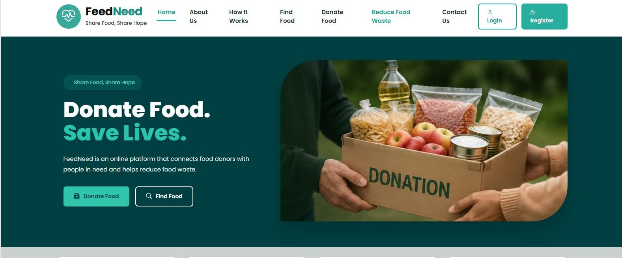
HOME PAGE

Slide 10
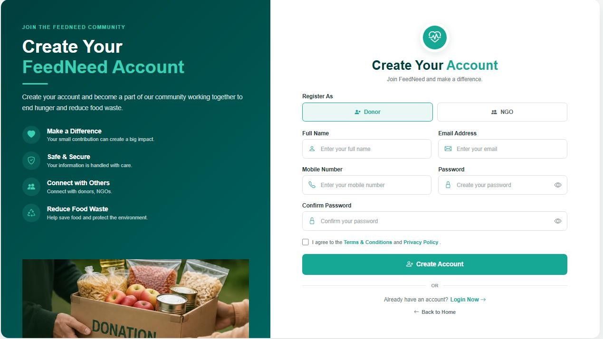
Register Page

Slide 11

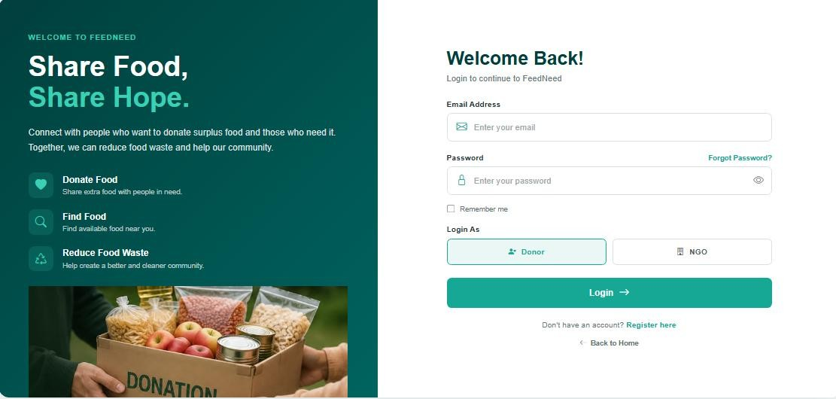
Login Page

Slide 12
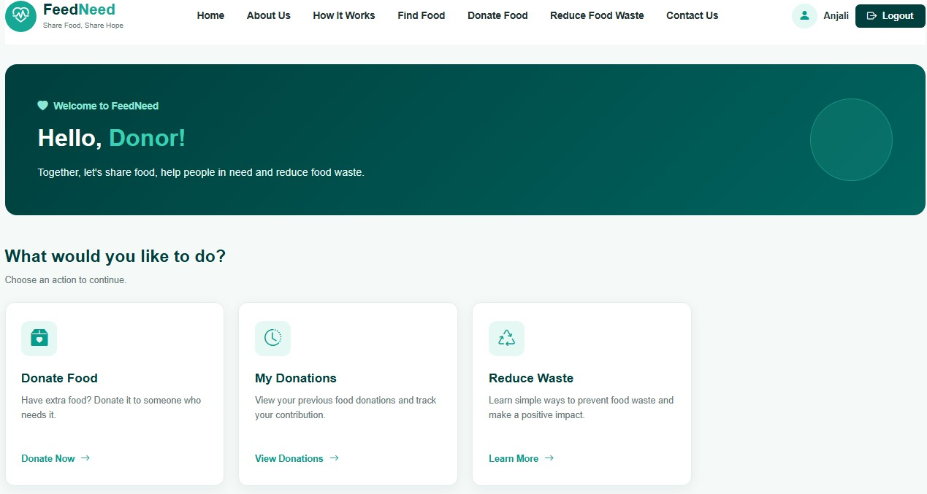
Dashboard Page

Slide 13
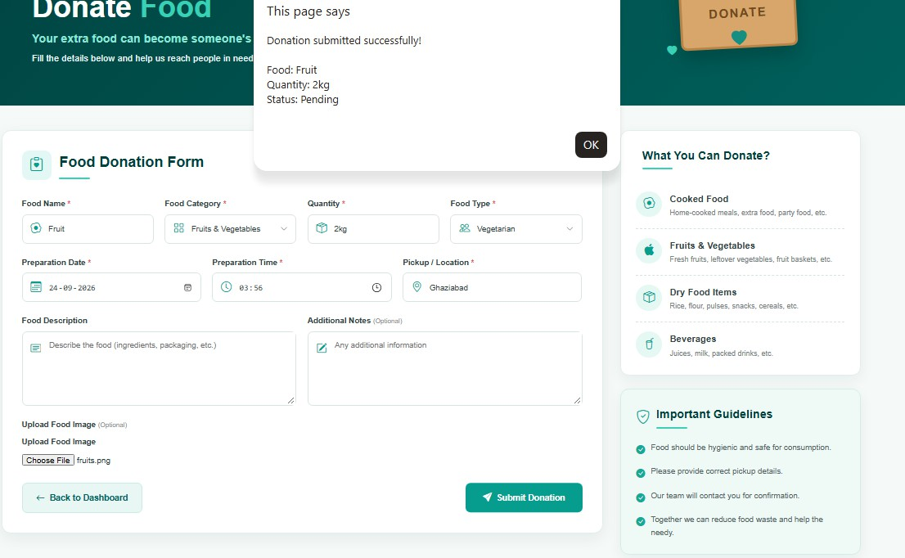
Donate Food Page

Slide 14
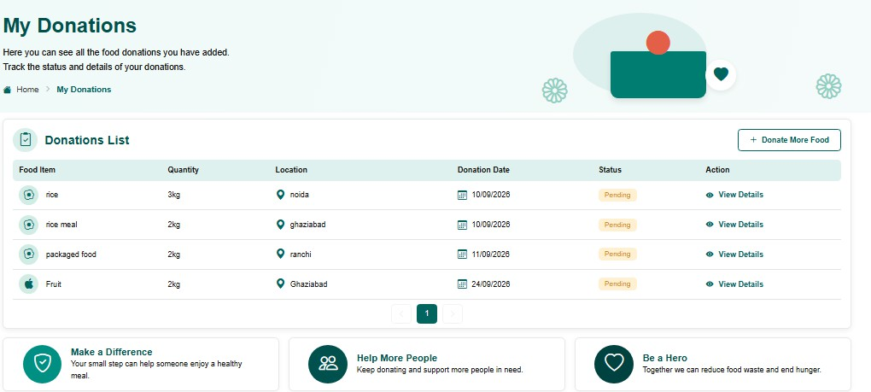
My Donations Page

Slide 15
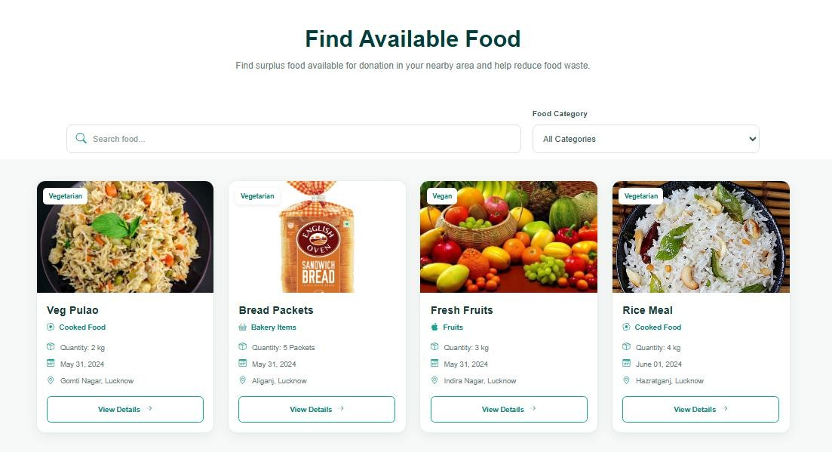
Find Food Page

Slide 16
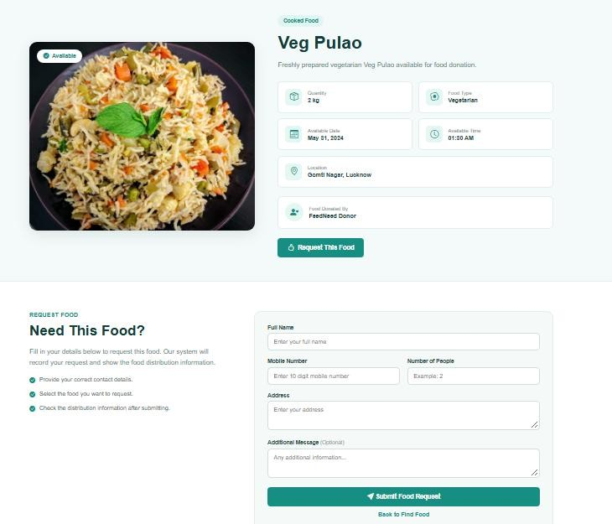
Food Details Page

Slide 17
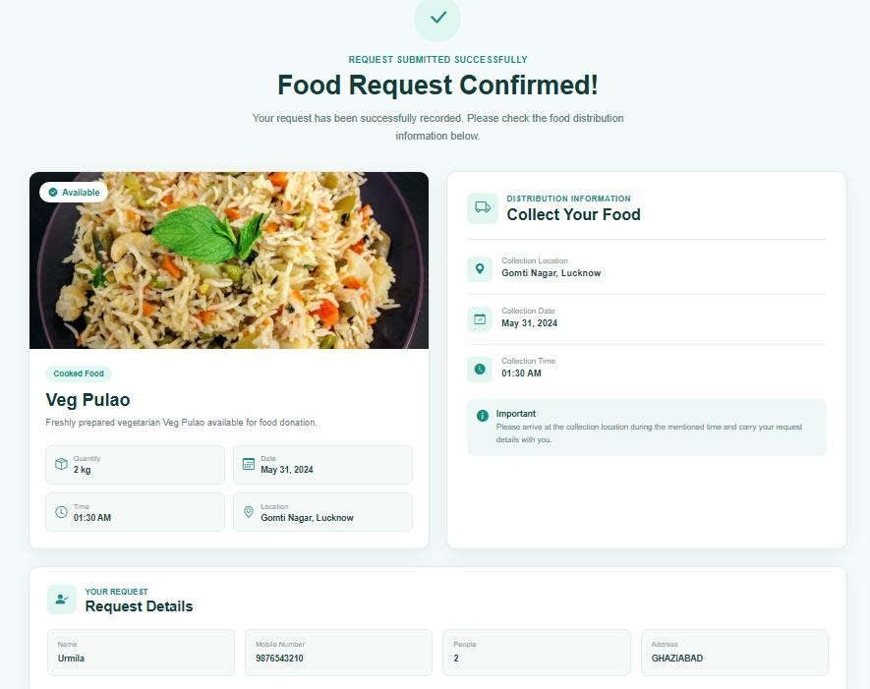
Food Distribution Page

Slide 18
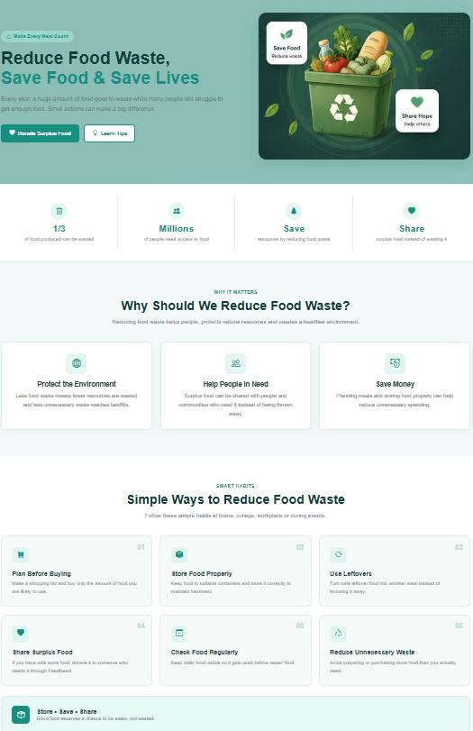
Reduce Food Waste Page

Slide 19
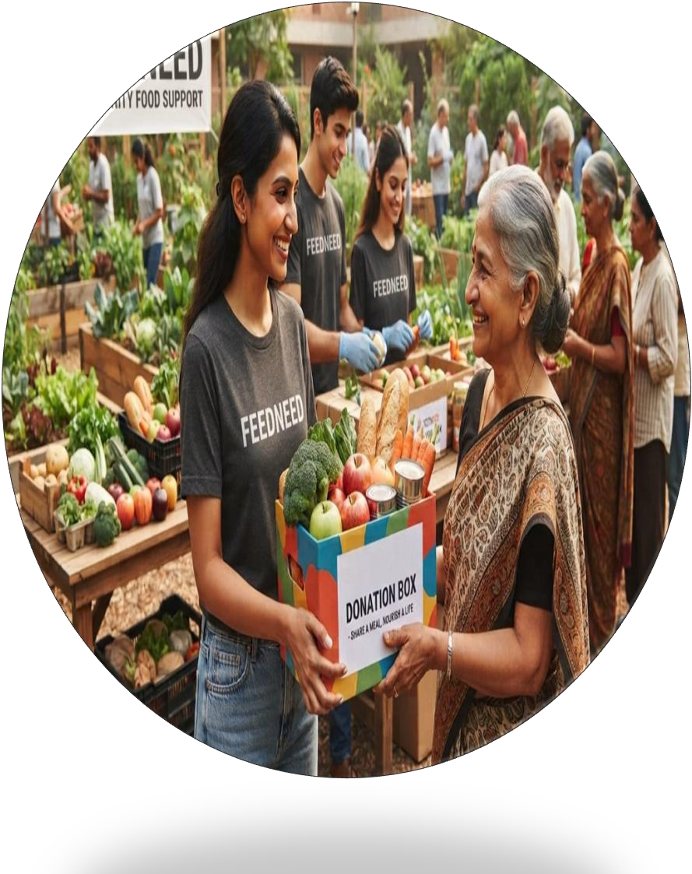
FeedNeed
Share Food Share Hope
CONCLUSION
FeedNeed provides a simple platform to share surplus food, reduce food waste, and help people in need. It makes food donation and distribution easier through a user-friendly website.

Slide 20


TEAM MEMBERS
FeedNeed
Share Food Share Hope
Urmila 240962106057
Gunja kumari 240962106014

Slide 21


Thank You
FeedNeed
Share Food Share Hope
Your supports helps us build a Hunger-free and waste-free world.

